Slide 1


Hii,
Iam Siddhika
Welcome to Power BI Series
Part -84

Slide 2


Today Content
I’m very excited to dive into this with you all!
Are you ready to enhance your data visualization skills?
VISUALIZING DATA
CURRENCY CONVERSION WITH SLICER IN POWER BI

Slide 3


INTRODUCTION TO CURRENCY CONVERSION WITH SLICER IN POWER BI
check next slide..
Objective: Allow users to convert between different currencies dynamically using a slicer and the SWITCH function in Power BI.
Key Concepts:
Currency Conversion: Adjusting financial data to display values in different currencies.
Slicer: A visual that allows users to select which currency they want to view the data in.
SWITCH Function: A DAX function that enables dynamic selection based on user input from the slicer.

Slide 4
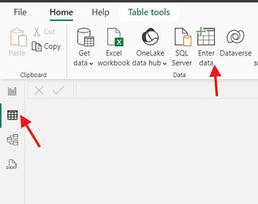

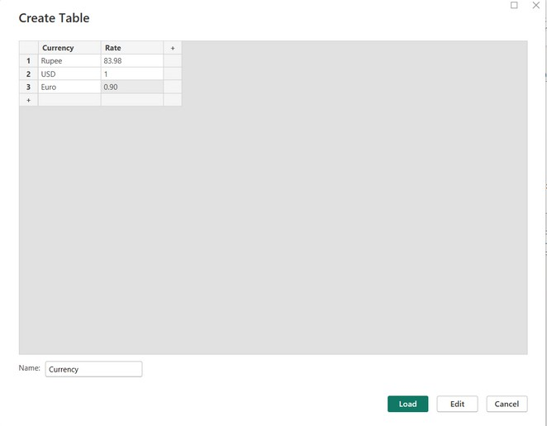
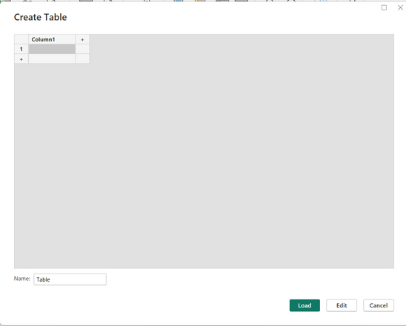
Step 1: Create a Table with Currency Rates
see next
1. Go to the Data View:
In Power BI, go to the Data view.
slide ..
2. Create a New Table:
Click on Enter Data and create a table named Currency with two columns: Currency and Rate.

Slide 5
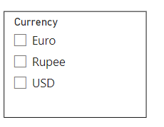

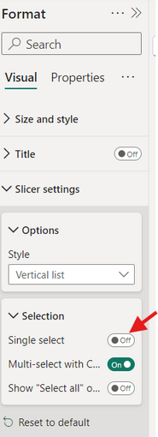
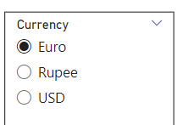
Step 2: Add a Slicer for Currency Selection
1. Add the Currency Slicer:
Drag the Currency column from the Currency table onto the canvas and change it to a Slicer visual.
do along with
me
2. Format the Slicer:
Set the slicer to allow Single Selection (so only one currency can be selected at a time).

Slide 6

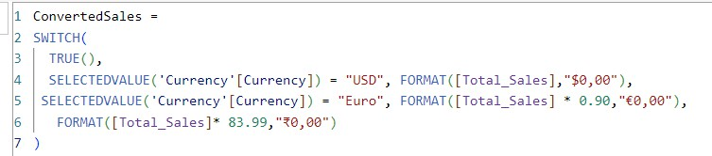

Step 3: Create a Measure for Currency Conversion
1. Create a New Measure:
Go to the Modeling tab and create a new measure to handle currency conversion using the SWITCH function:
Easy..see
next
SWITCH(TRUE(),...): This is a logical structure that tests multiple conditions and returns the appropriate result based on the selected currency.
SELECTEDVALUE('Currency'[Currency]): This picks the value from the slicer (Currency) that the user selects, such as "USD," "Euro," or "Rupee."
Conversion logic:
If the user selects USD, the Total_Sales are shown in USD format (e.g., $12,345).
If Euro is selected, the Total_Sales is multiplied by 0.90 (a sample conversion rate), and formatted as Euro (e.g., €11,110).
Fallback: If none of the conditions match, the Total_Sales is multiplied by 83.99 (a sample conversion rate for INR) and displayed in Rupees (e.g., ₹1,035,678).

Slide 7
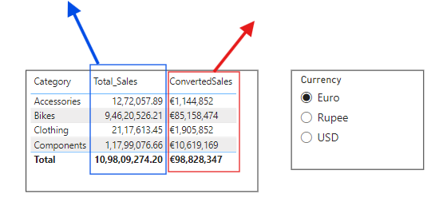
Step 4: Add Visual to Display Converted Sales
Add a Visual:
Drag a visual like a Card or Table onto the report canvas.
Set Data Fields:
Drag the ConvertedSales measure onto the visual.
try it..
normal measure
ConvertedSales
,which is not
measure ,which is n
changing..
changing..
Result: The total sales will now display in the selected currency, based on the slicer.

Slide 8
Step 5: Test Currency Conversion
Interact with the Slicer:
Select different currencies in the slicer to observe the converted sales values updating dynamically.
Explanation:
This setup allows users to easily toggle between currencies and view sales data in their desired currency.
Go and
try..

Slide 9


Thank you for joining me today to learn about Part -84 of Power BI!
Remember, Effective data visualization is crucial for turning data into meaningful insights and compelling narratives with Power BI.
Stay tuned for more insights and tips on Power BI in our next Series.
Follow
Siddhika Shah

